Slide 1
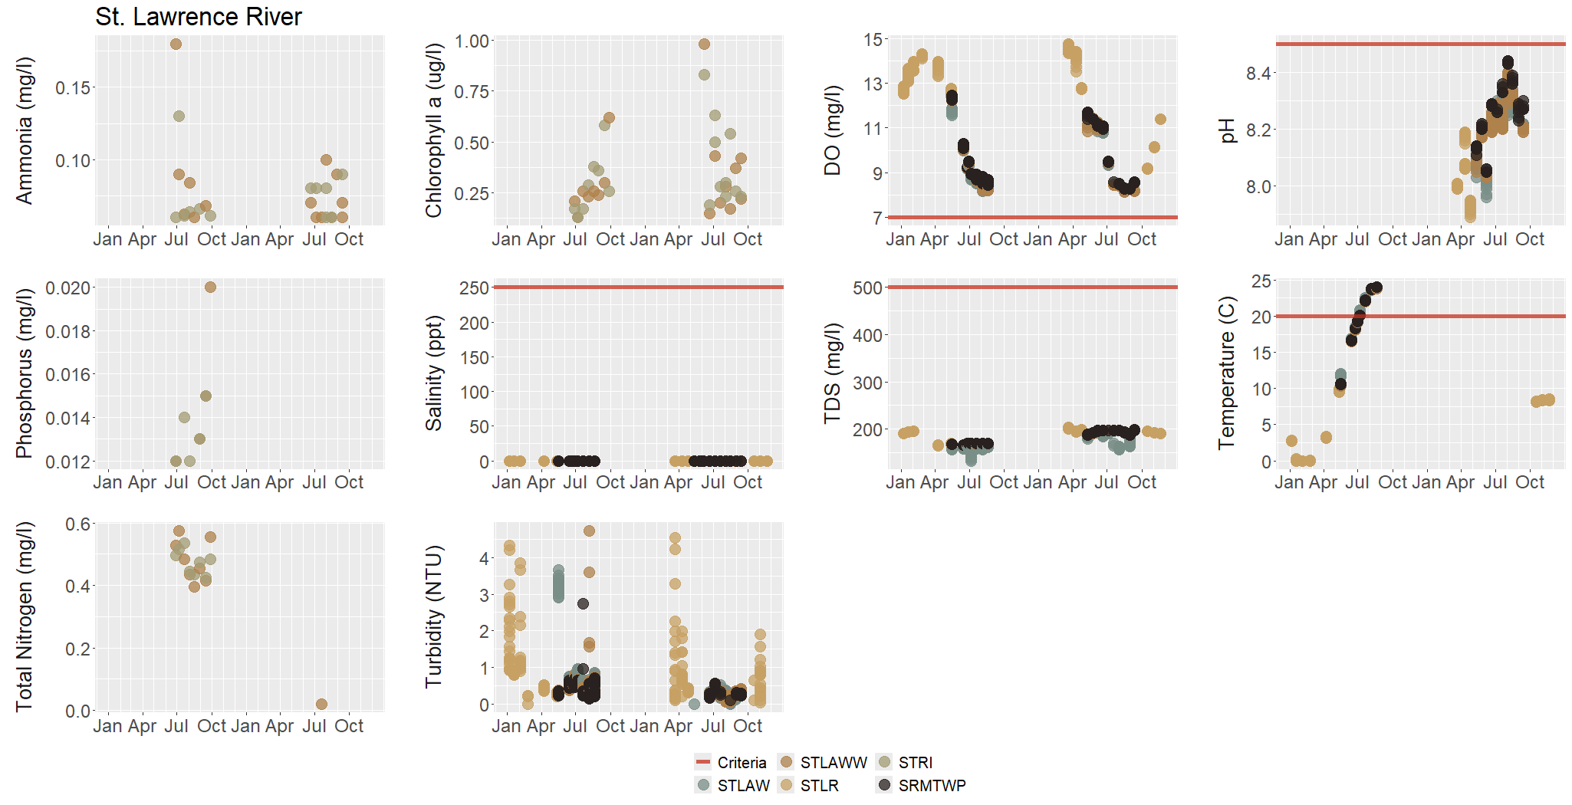
Automatically pulls data into a central location
Puerto Rico Water Quality Assessment App
Data review & cleaning
Review & clean of WQS and sampling data
Review GIS (AUs and monitoring locations)
Review previous ATTAINS cycle
Compares water quality samples to relevant standards
Make assessment
Export: report, tables, ATTAINS CSV files
Build in assessment methodology
Export reports, tables, maps, etc.

Slide 2
Puerto Rico Water Quality Assessment App

